Slide 1
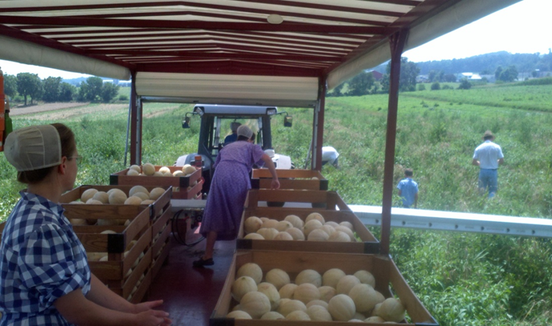
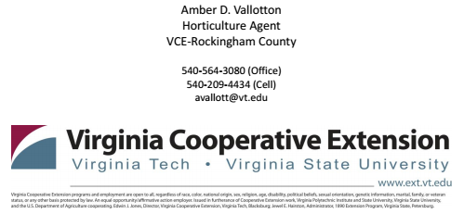
GAP-Certification Process
Amber Vallotton
Fresh Produce Food Safety Coordinator & Extension Specialist
Dept. of Horticulture, Virginia Tech, Blacksburg, VA

Slide 2
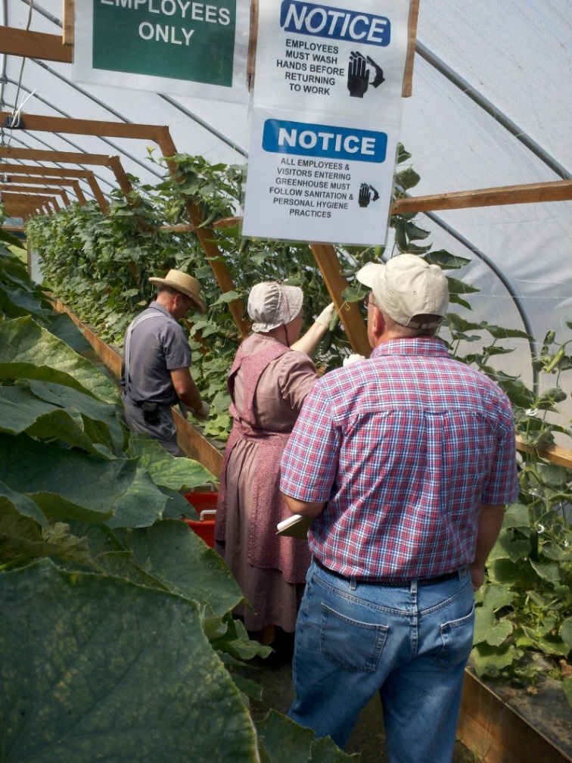
GAP Certification Preparation
Two Main Components:
Written Plan of Action (POA)
  Specifies procedures/policies, and documentation to meet GAP checklist
On-farm walkthrough inspection
  Using risk assessment framework, incorporating into practice what grower says they’ll do in manual (i.e. on-farm compliance)

Slide 3

A Word of Encouragement
This process, especially the POA manual, can seem daunting and overwhelming: My goal is to try to give you BIG PICTURE and most important points!

Slide 4
Orientation to Contents of the
Plan of Action (POA) Manual
Table of Contents
Various Sections of Audit Checklist Questions and Answers
Standard Operating Procedures
Record/ Logs
Supporting Documents

Slide 5
Plan of Action (POA) Manual
Table of Contents
  Comprehensive listing of contents for each section

Slide 6
Audit Checklist Questions and Answers
Includes different sections of the USDA GAP/GHP Audit
  Excel spreadsheet style format of Q&A (“template”)
  Takes the identical questions from the USDA GAP Audit Verification Checklist used by inspectors
  Includes required questions (Demographics, General Questions, and Part 1: Farm Review)
  Additional sections as applicable
  Answers generally describe policies/standard operating procedures (SOPs)
  Notes make reference to SOPs, records, and other supporting documents

Slide 7
General Format for Templates
Audit Question
Response
Indicate Y/N/NA
Indicates Policy is required
Numbered Document
2-5a

Slide 8
Sections of Checklist Questions and their Specific Foci
Demographic Questions
  Contact Info, training, farm maps, flow plan
General Questions
  Food safety plan, worker health and hygiene, traceability
Part 1: Farm Review
  Water usage, water quality risks, sewage treatment, animals/wildlife/livestock, soil amendments, traceability

Slide 12
Additional Sections
In addition to required demographic, general questions, and farm review questions, other sections which may apply to your farm include:
  Field Harvesting and Field Packing Activities (Part 2)
  House Packing Facility (Part 3)
  Storage and Transportation (Part 4)
  Wholesale Distribution Center (Part 6)
  Preventive Food Defense (Part 7)

Slide 13
Standard Operating Procedures
Outlines farm policy related to food safety
SOPs details step-by-step how a specific operation or activity is done on the farm
Example: SOP on hand harvesting equipment specifies procedures for sanitizing equipment, how regularly, and what log (record sheet) will be used for documenting this practice
In POA section, a “P” indicates that a policy/SOP must be documented in the food safety plan in order to show conformance to the question

Slide 16
Record/ Log Sheets
Documents when and who performed specific standard operating procedures
Also, when needed, details what actions were taken to be in compliance with a given SOP/policy
Records/logs should closely coincide with specific SOPs, i.e. there should be consistency between what you said you were going to do and when you did it!
In the POA section, an “R” indicates that a record is required to show an action was taken

Slide 19
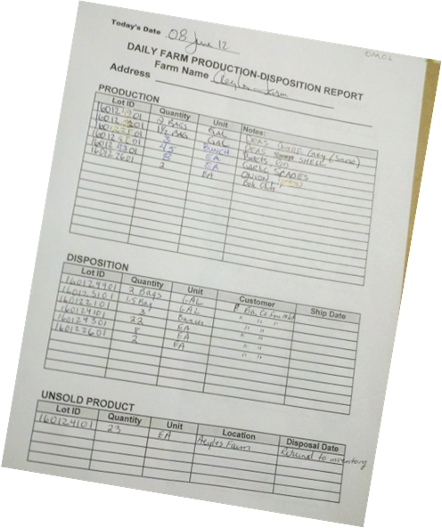
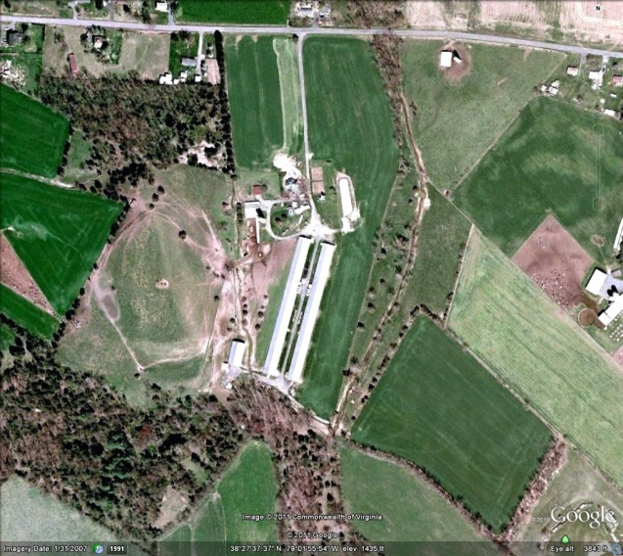
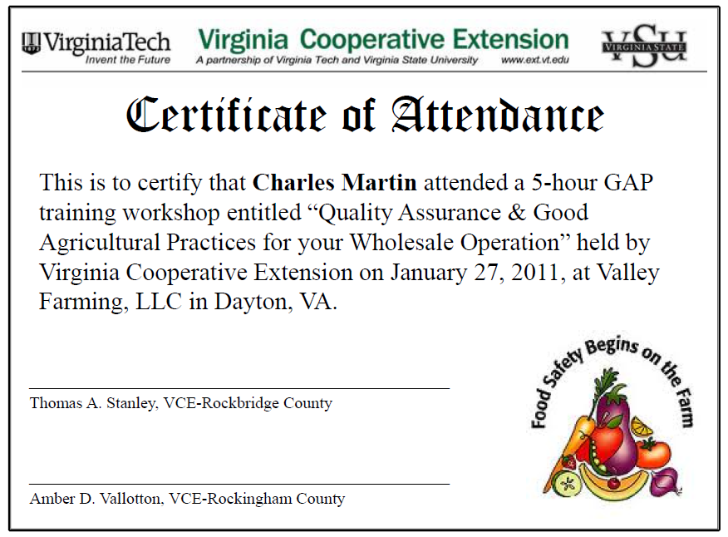

Supporting Documents
Helps substantiate a response to an audit question
Includes certificates of training, Google Earth maps of farm with field codes, drawings showing packing house flow zones, farm self-assessments, water test results, traceability records, pesticide logs, training records, etc.
In the POA section, a “D” indicates that a document is required

Slide 20
Review: Audit Preparation Process
To be GAP-certified, must complete written Plan of Action (POA) and on-farm walkthrough as part of audit process
  POA describes how you will satisfy GAP requirements & supported by LOTS of Documentation
  On-Farm Compliance shows you have implemented and documented what your POA lays out!
Main steps are to create POA Manual & to get your farm into compliance with practices and documentation so you can obtain third-party audit (see To-Do Checklist in handouts)

Slide 21
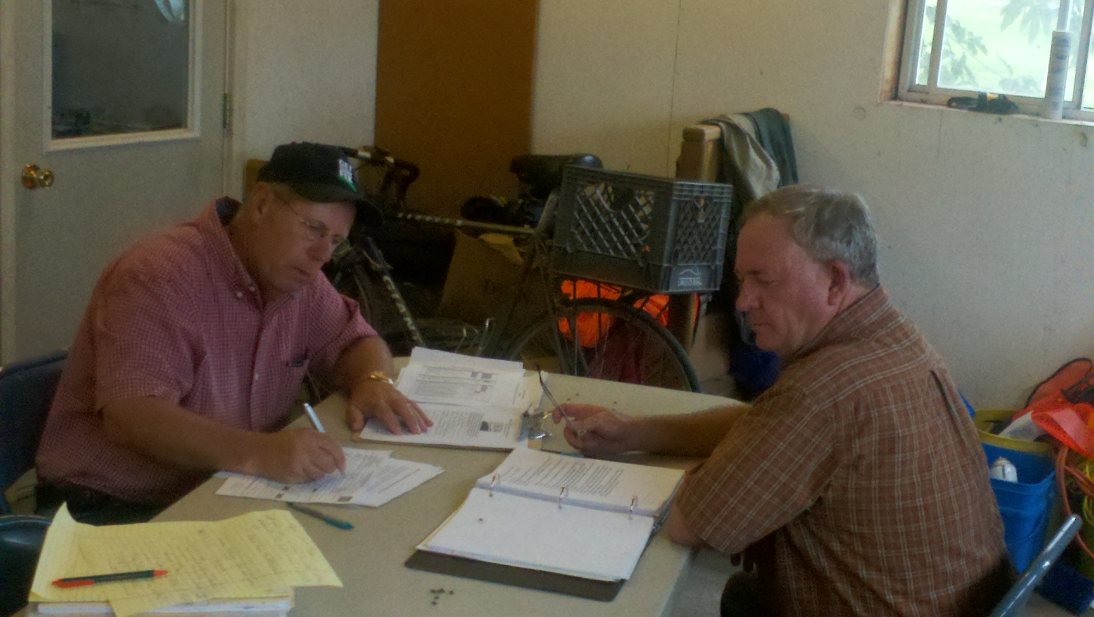
Actual Audit Day!
Reviewing the POA Manual

Slide 22
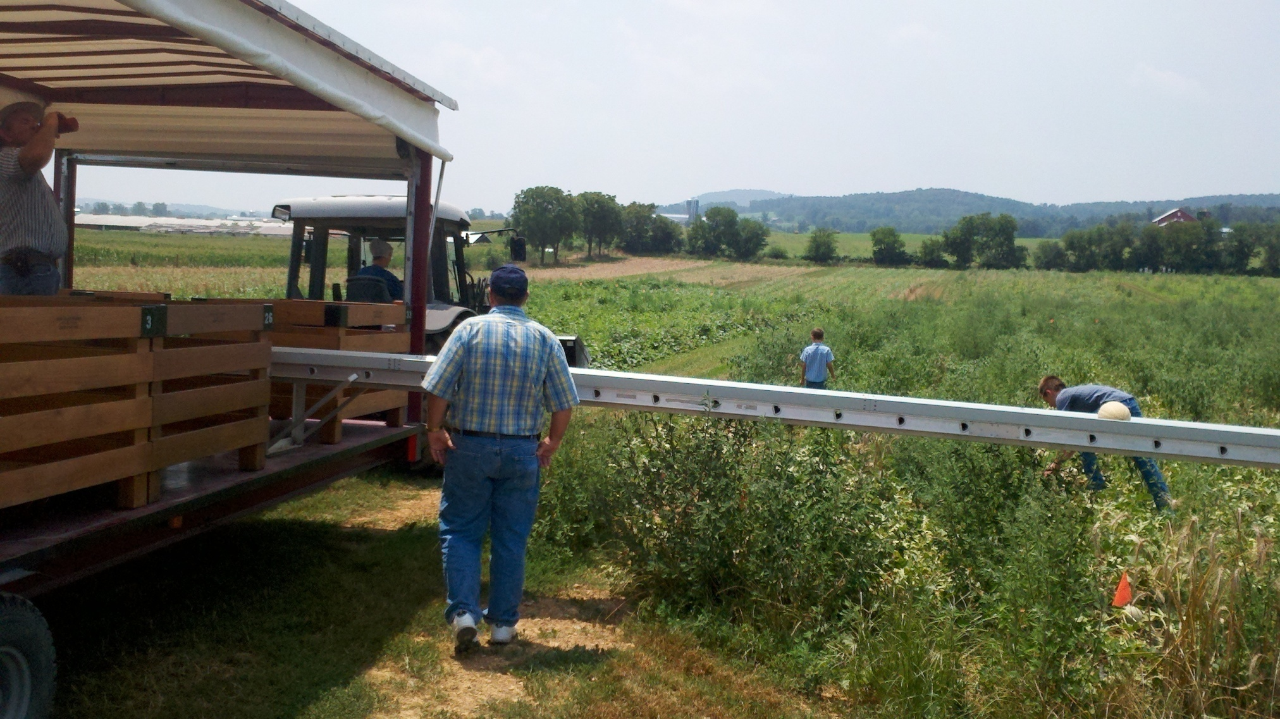
Observing On-farm Practices

Slide 23
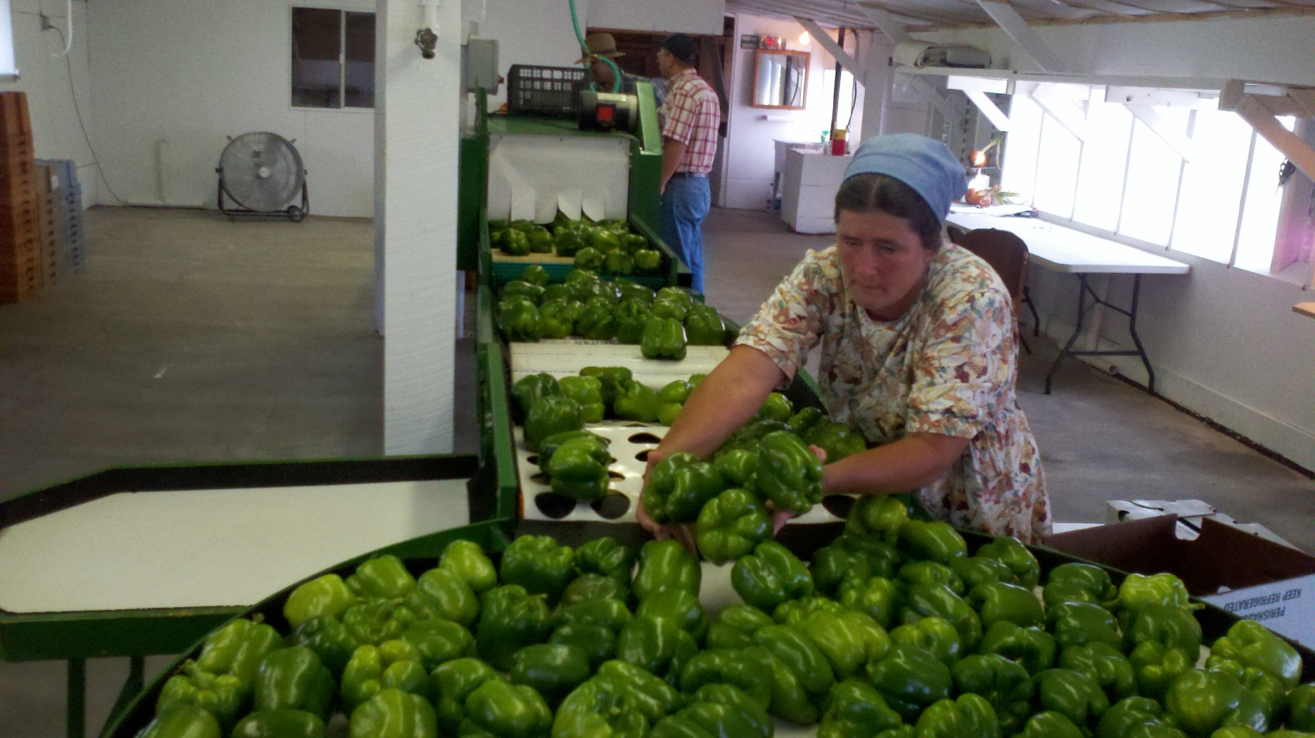

Slide 24
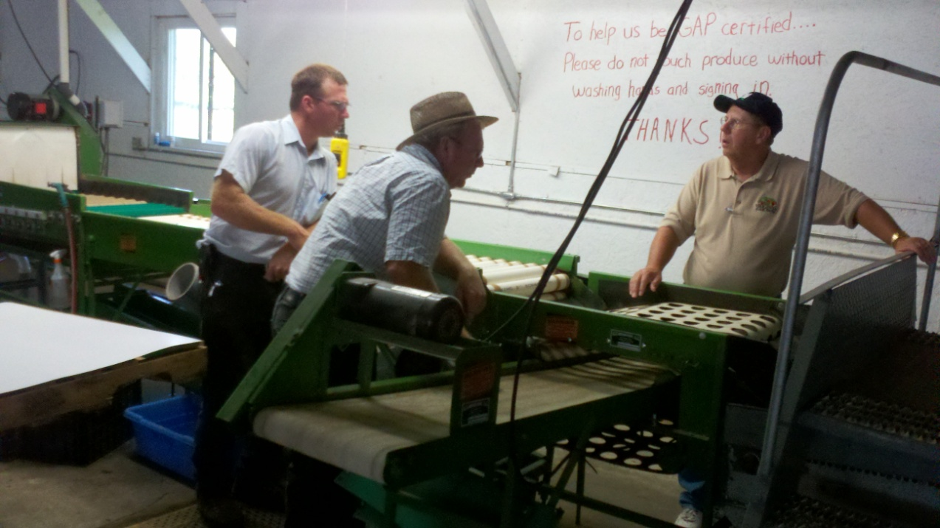
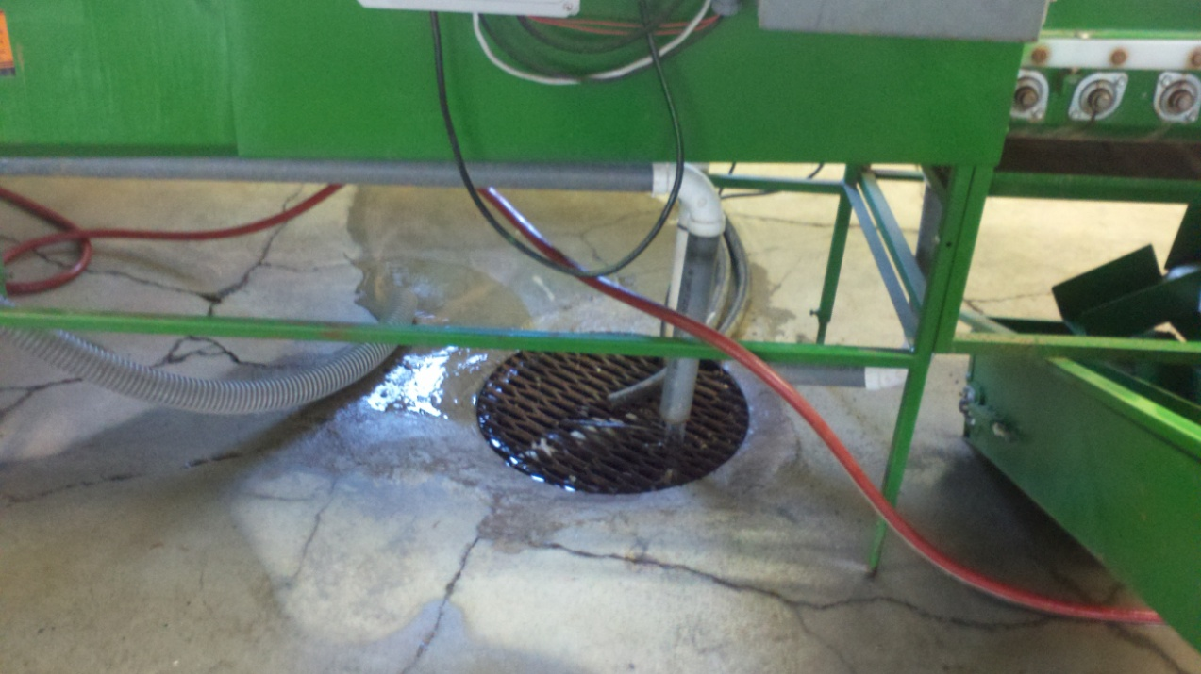
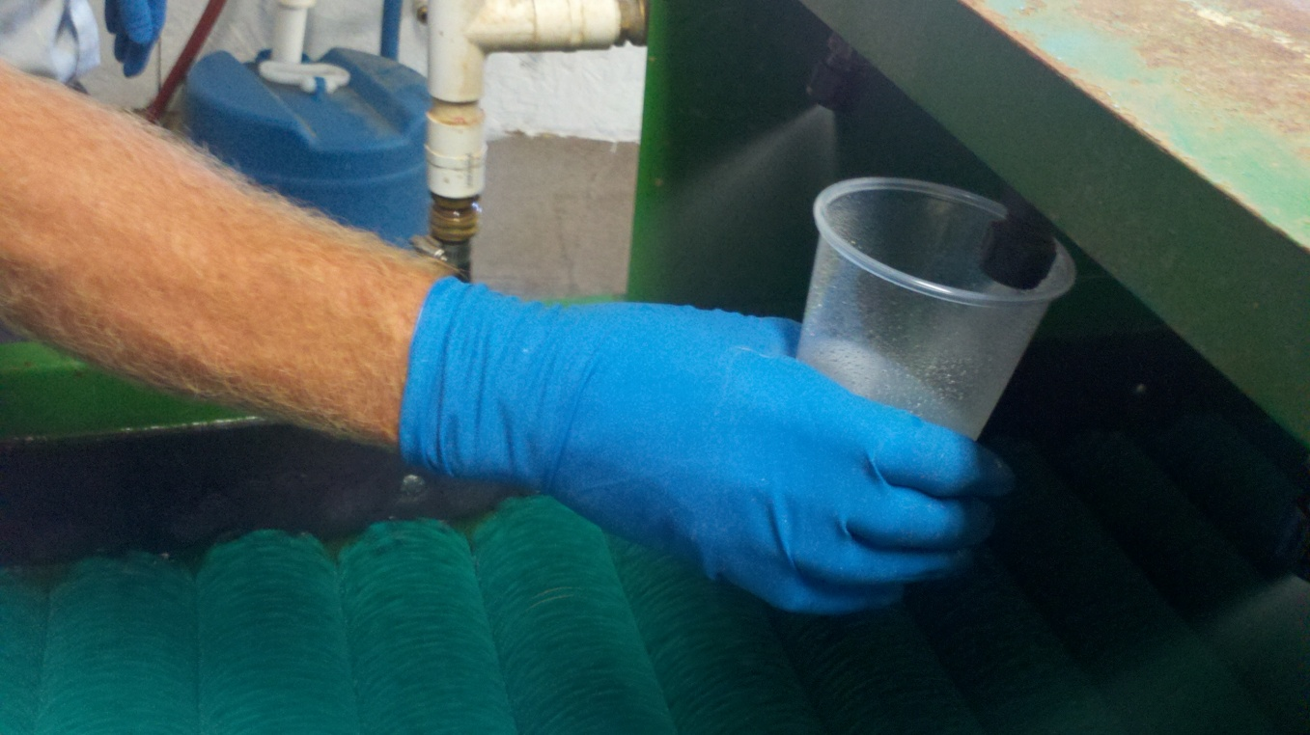
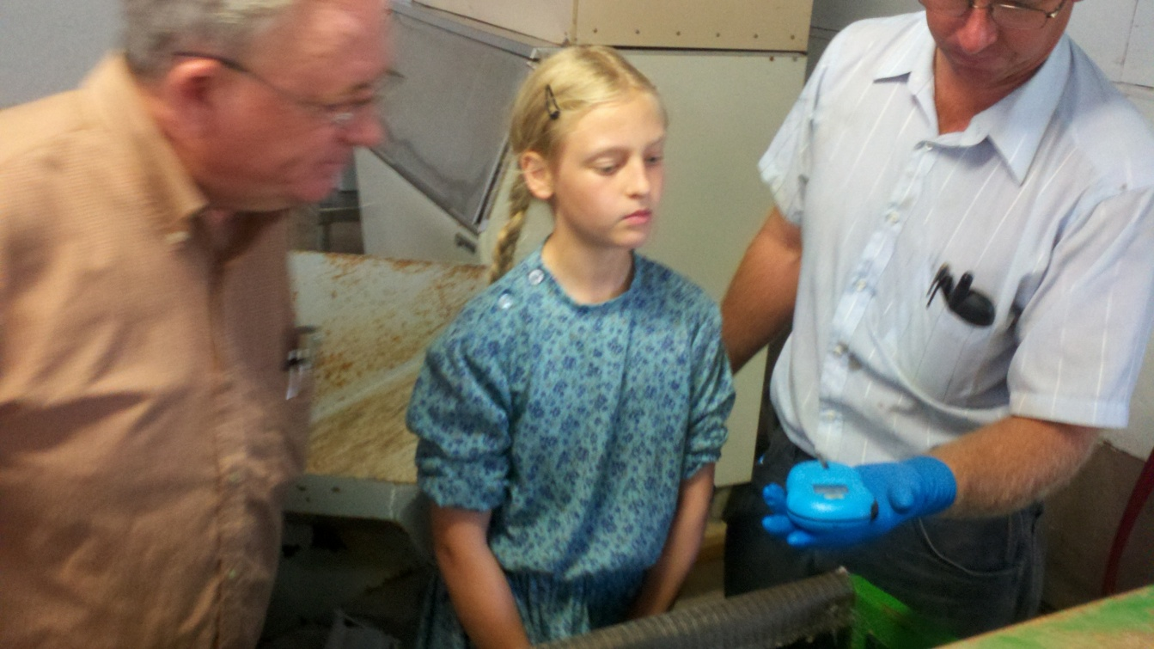

Slide 25
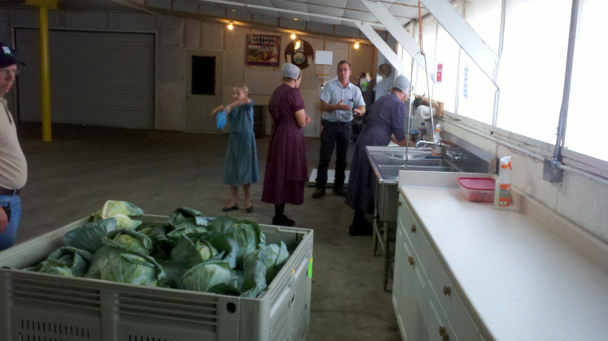
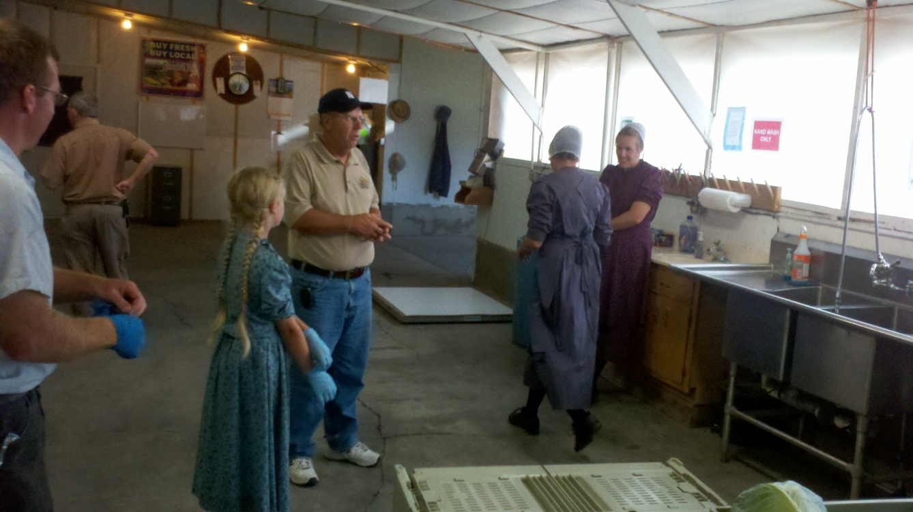
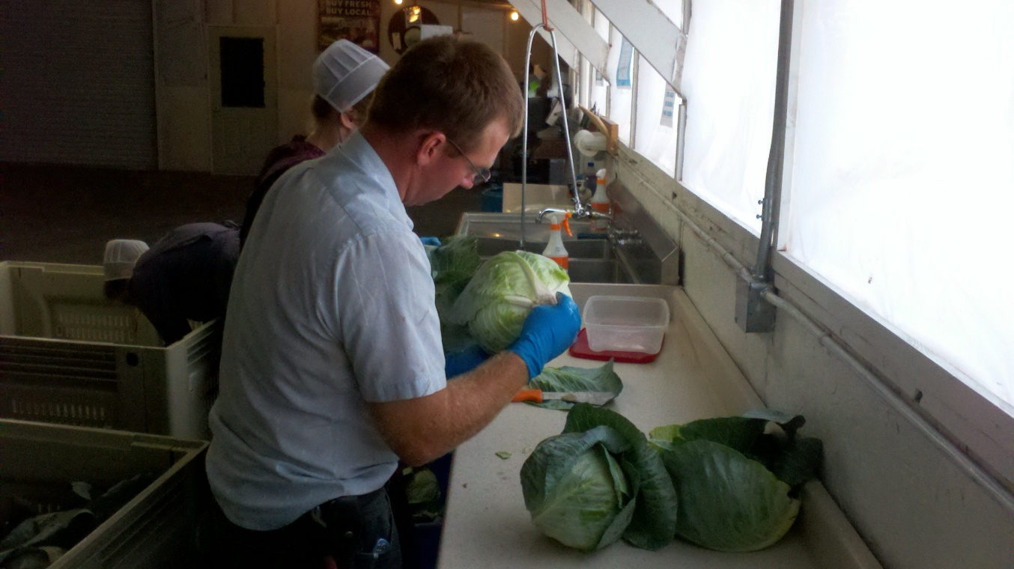
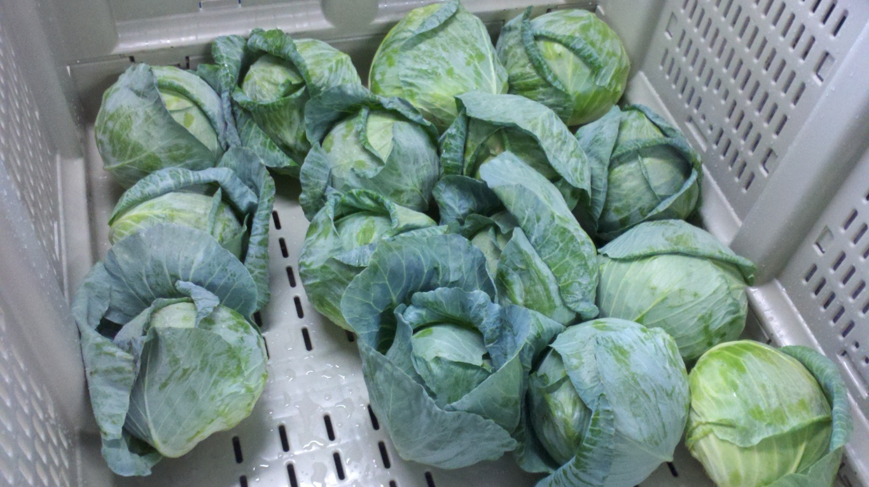

Slide 26
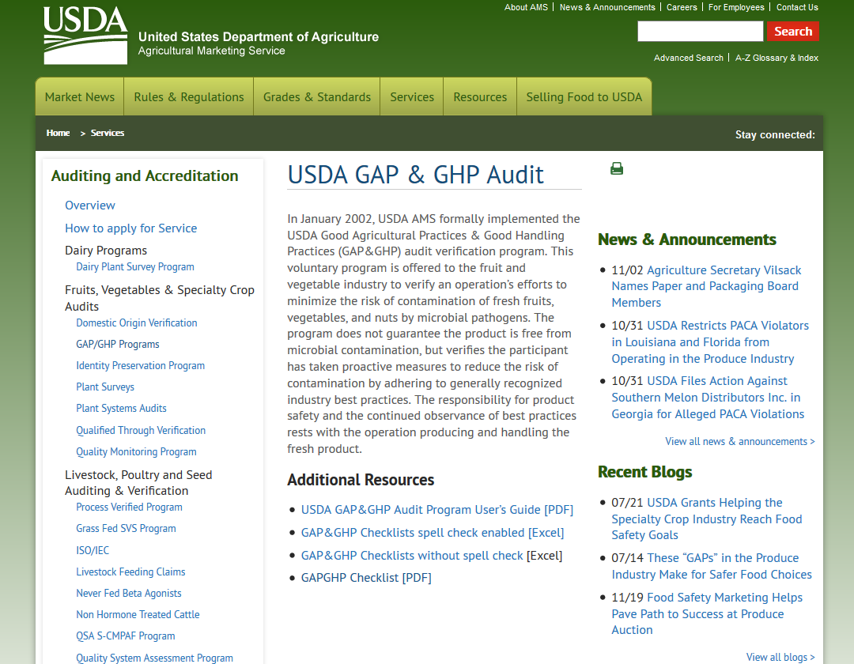
https://www.ams.usda.gov/services/auditing/gap-ghp/audit

